Slide 1
Welcome to Symbiosis center for distance learning
Project Name : Kia Cars
Developed by : Bhaskar
Tested by : Shreyash Kanhed
Ashay Kotangale
Bhagyashri Deshpande
Neha Sharnagat
Anand Dahihande

Slide 2
What need to be done?
Testing type : Exploratory Testing
Tools Needed : Jira, Zephyr, Excel file, TestNG
Who will perform pertiular task :
Anand Dahihande : Parallel and Cross Browser testing, Home, Models, FAQ’s, Highlight, Search Box, Search button and Slides.
Shreyash Kanhed : Social Media Links ( Facebook, Instagram, Twitter, linkedin)
Neha Sharnagat : Contact form
Ashay Kotangale : Functional and GUI testing, FAQ’s and Highlight Part, Overview, others and connect with us links.
Bhagyashri Deshpande : Merge all the test cases and create defect report manually.

Slide 3
RoadMap
Understand the Page of kia Cars
Written test cases in excel
Created Epic and stories in jira and assign to particular tester
Created test cycles and executed test cases.
Create automation scripts using testNG
Written test cases in zephyr
Create issue if found any bug in zephyr
Note down the same bug in excel sheet.

Slide 4
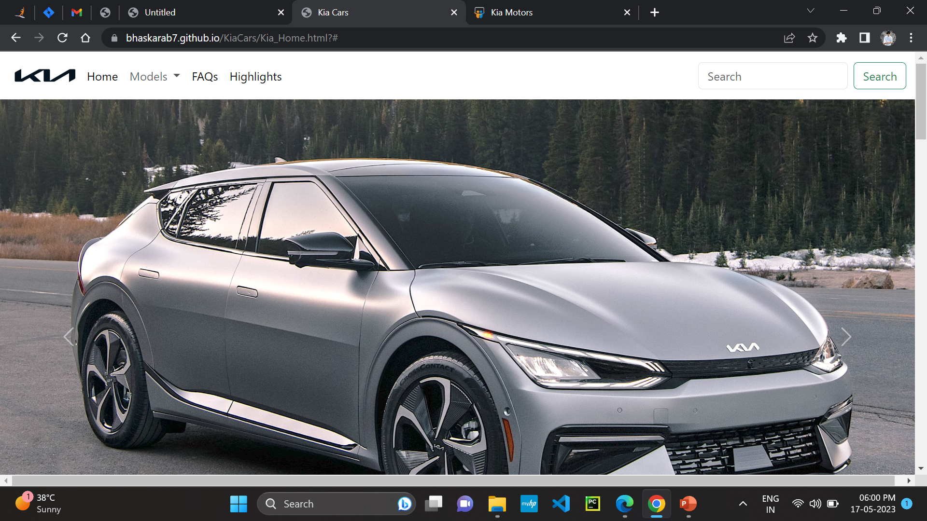
Cross Browser and Parallel testing, Home, Models, FAQ’s, Highlight, Search Box, Search button and Slides.

Slide 5
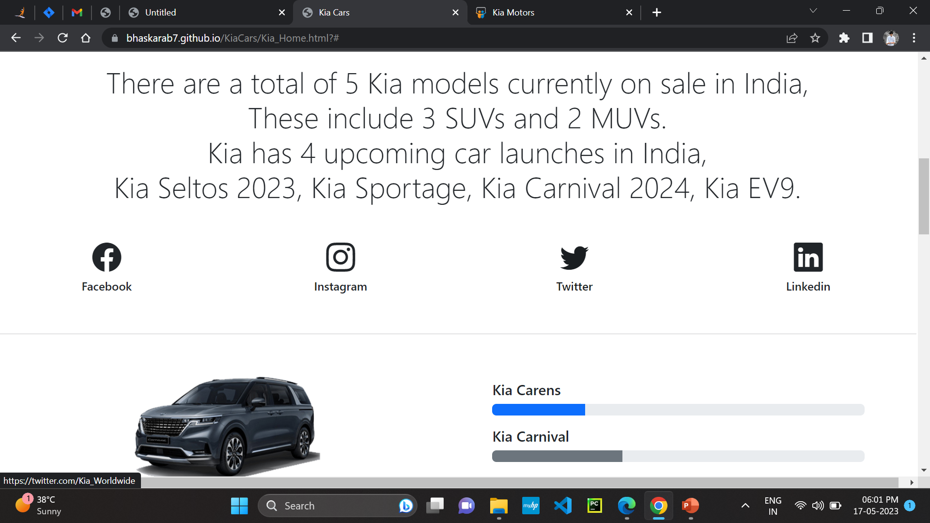
Social Media Links ( Facebook, Instagram, Twitter, linkedin)

Slide 6
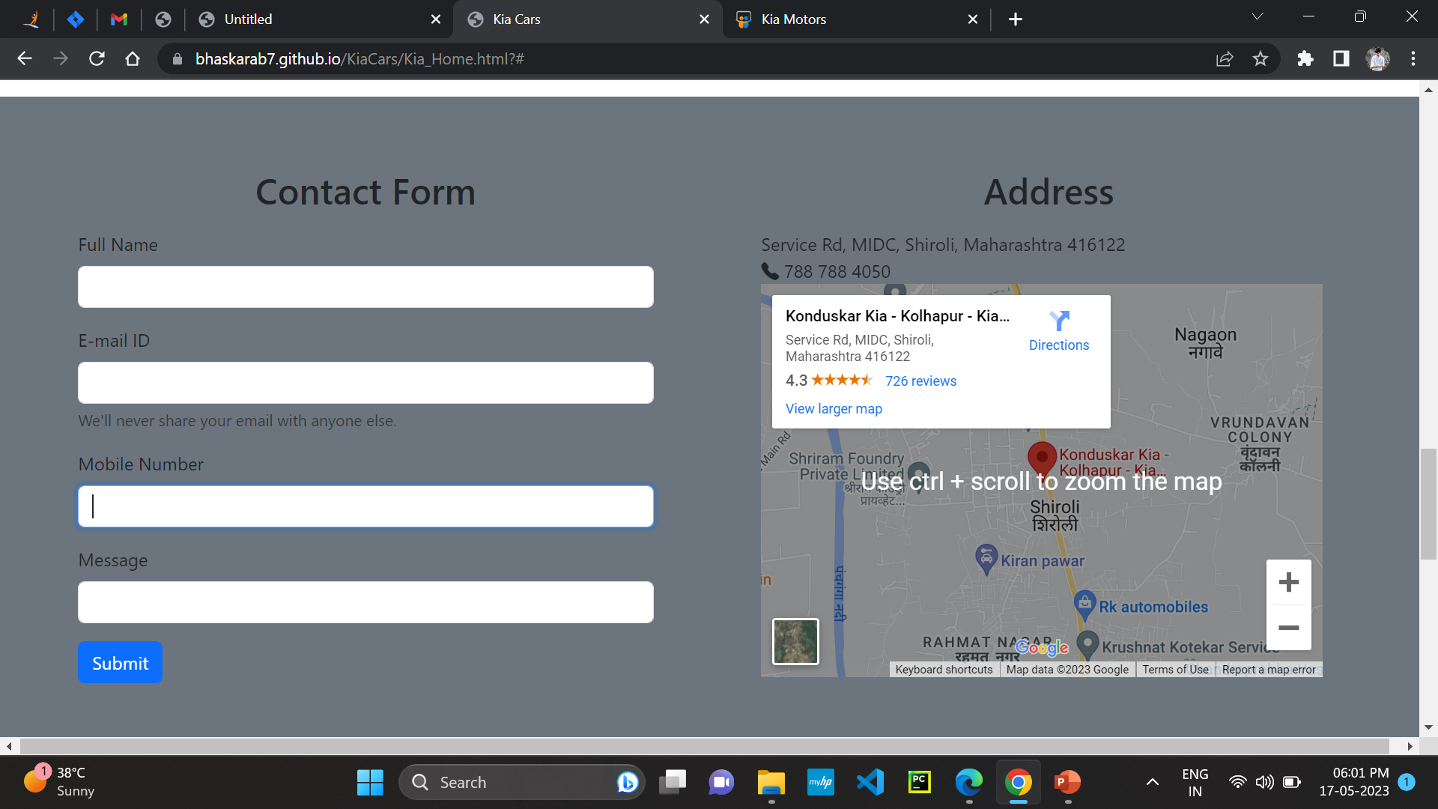
Contact form

Slide 7
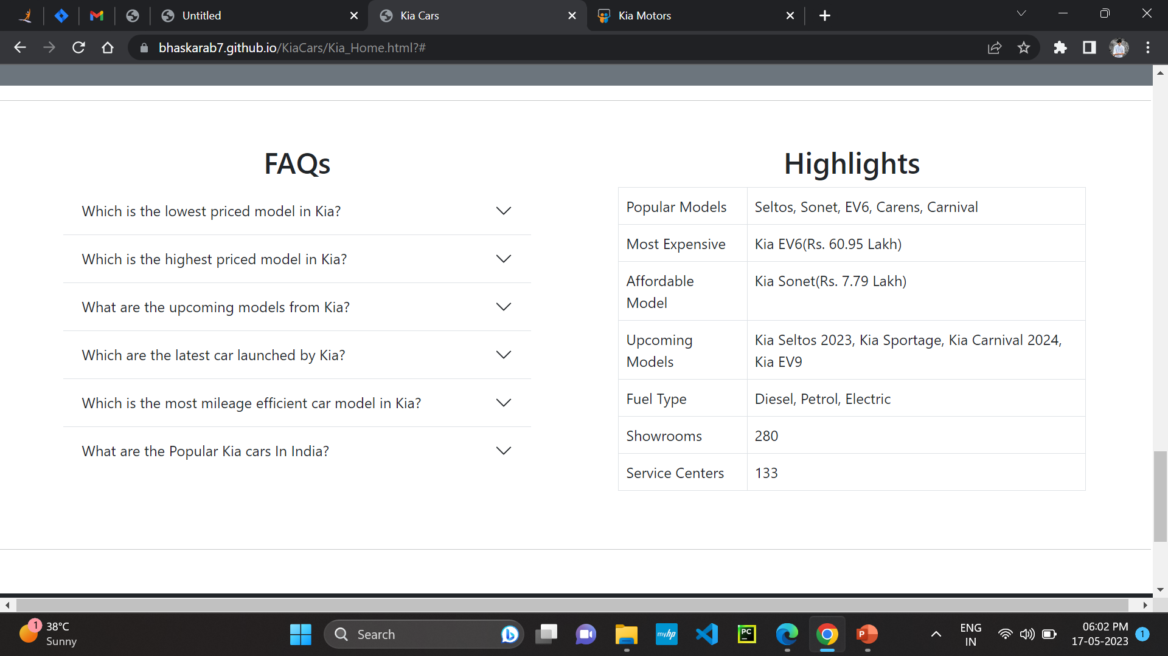
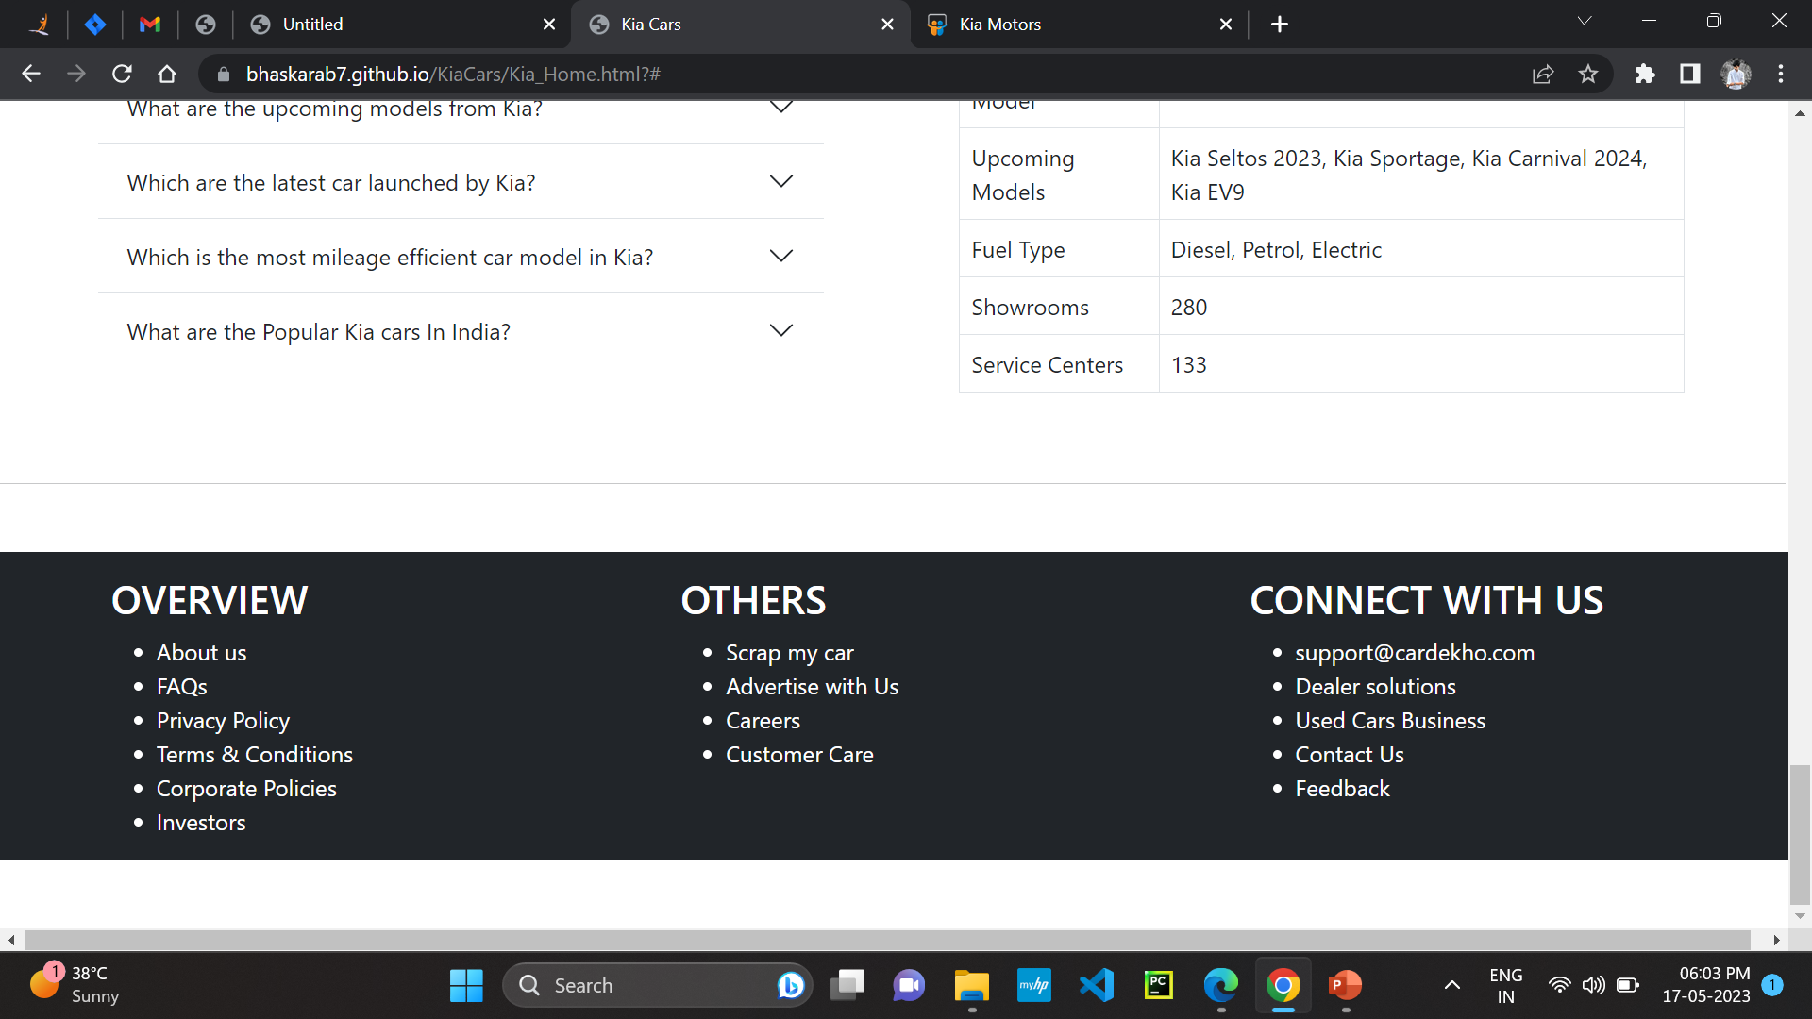
Functional and GUI testing, FAQ’s and Highlight Part, Overview, others and connect with us links.

Slide 8
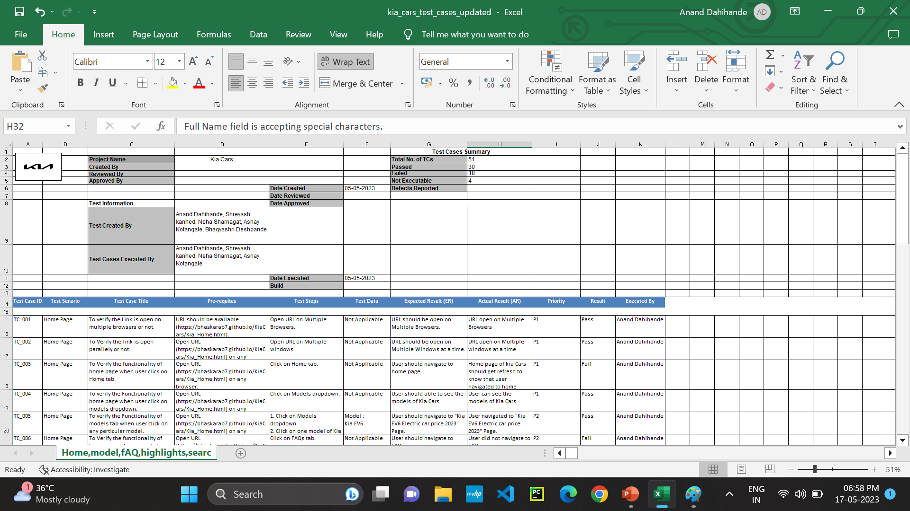
Test Cases

Slide 9
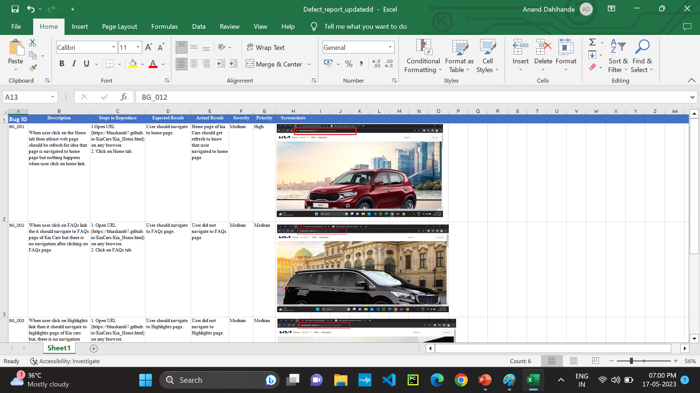
Defect/Bug Report

Slide 10
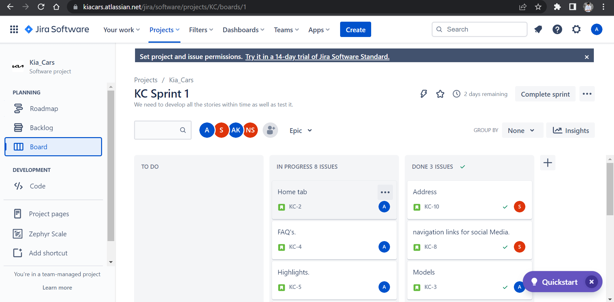

Slide 11
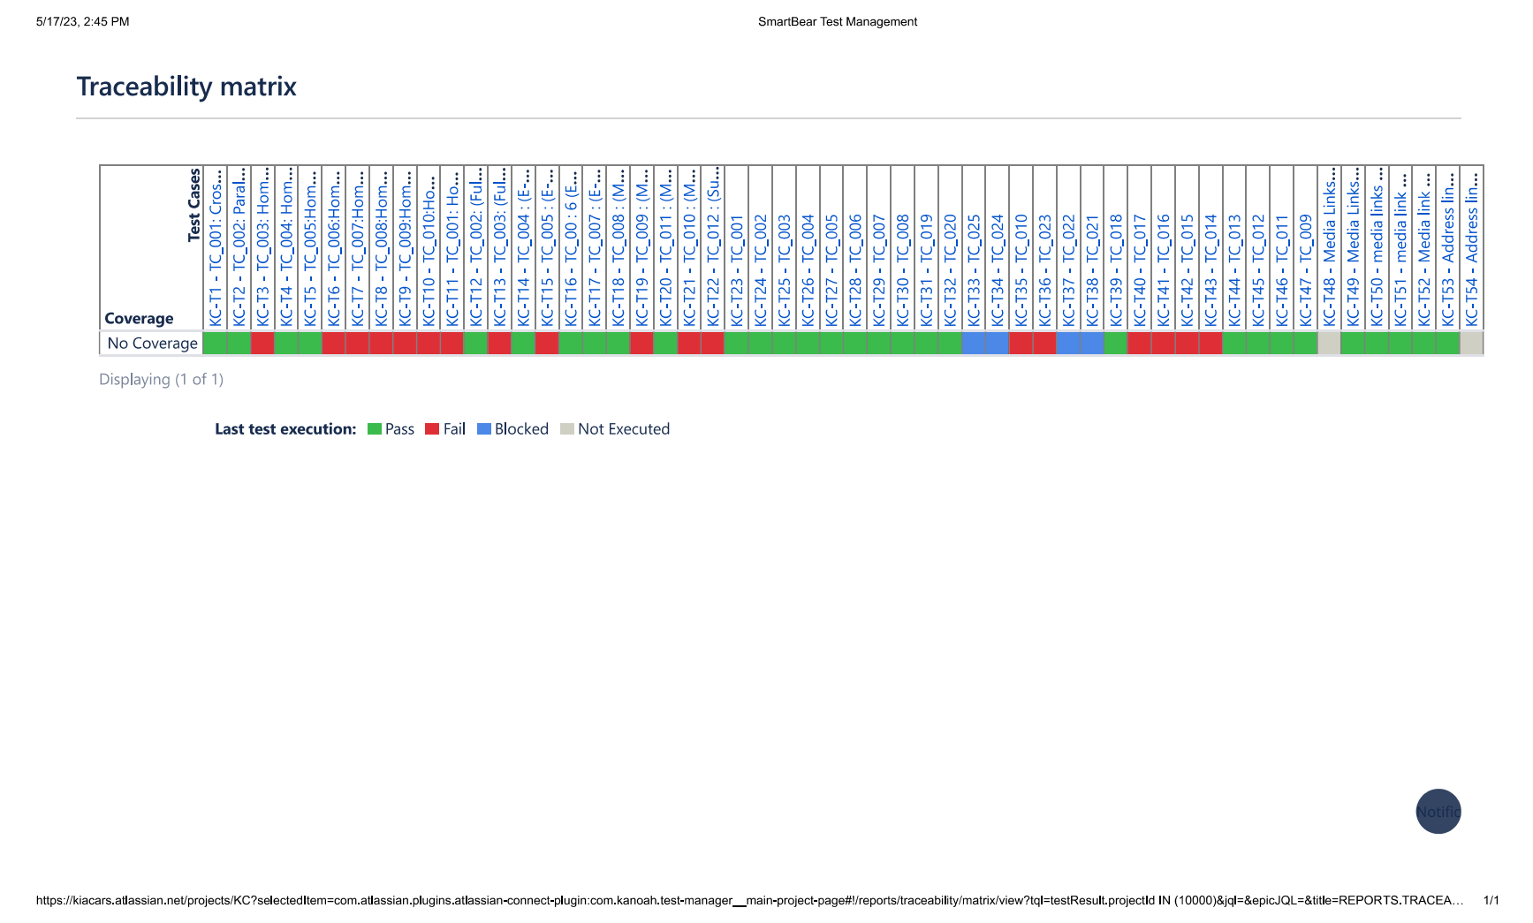

Slide 12
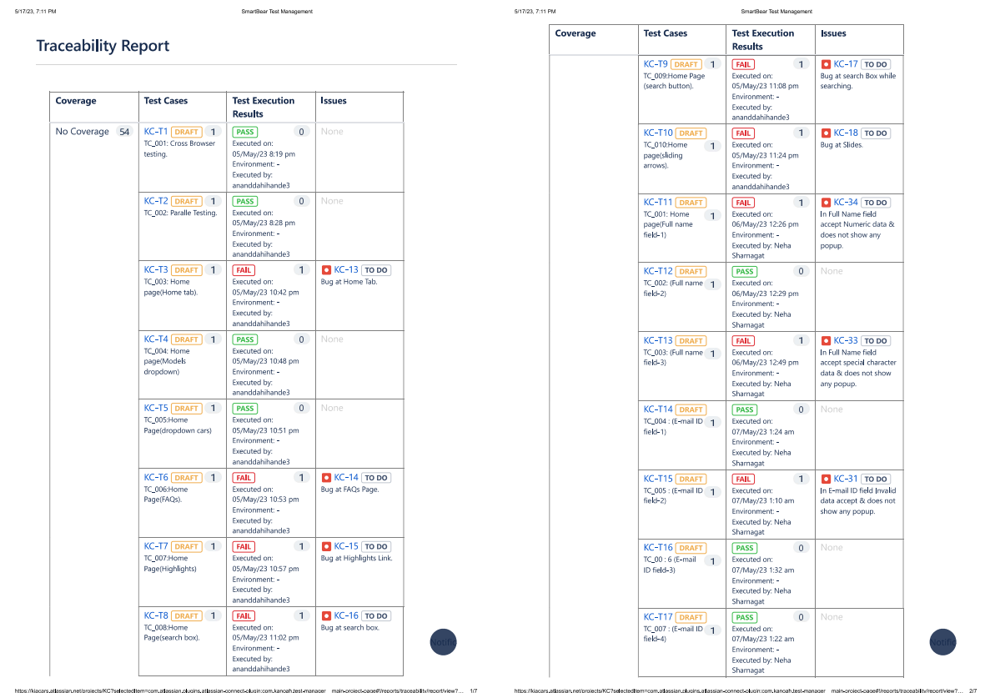

Slide 13
Thank You!!

